Slide 1



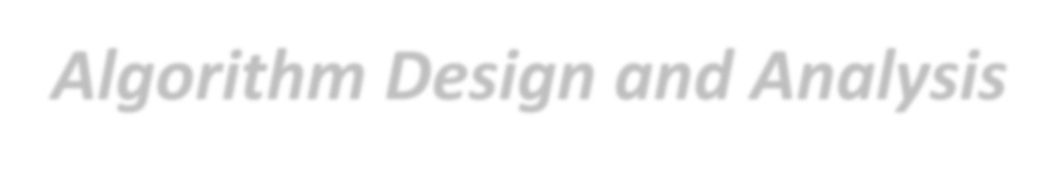
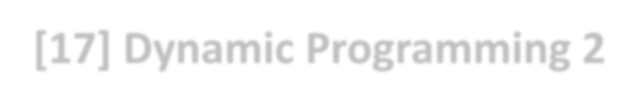
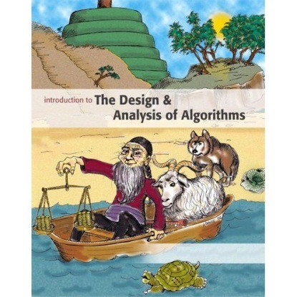
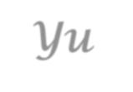
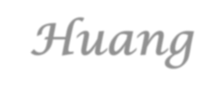

Introduction to
Algorithm Design and Analysis
[17] Dynamic Programming 2
Yu Huang
http://cs.nju.edu.cn/yuhuang Institute of Computer Software Nanjing University

Slide 2
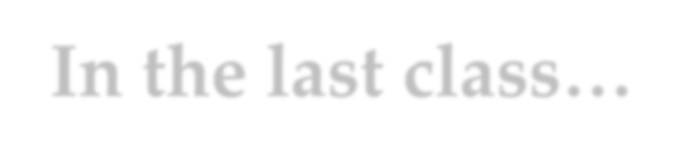
In the last class…
Basic idea of dynamic programming
Least cost of matrix multiplication
BF1, BF2
A DP solution
Weighted binary search tree
The same DP solution

Slide 3



Dynamic Programming - II
All-pair shortest path
Edit distance
Separating Sequence of Words
Changing Coins
Other DP problems
Elements of Dynamic Programming

Slide 4
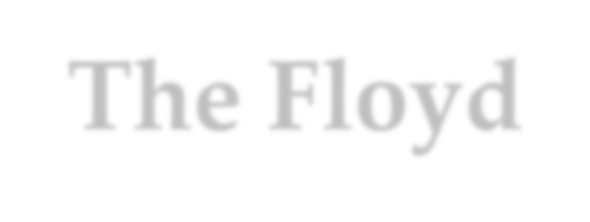



The Floyd-Warshall Algorithm is also DP
“Brute force algorithm 2”
Path length k
k in [1, n]
Floyd-Warshall algorithm
Intermediate node index k
k in [1, n]

Slide 5
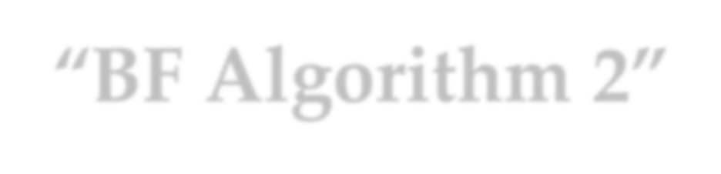


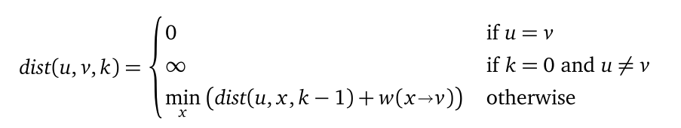

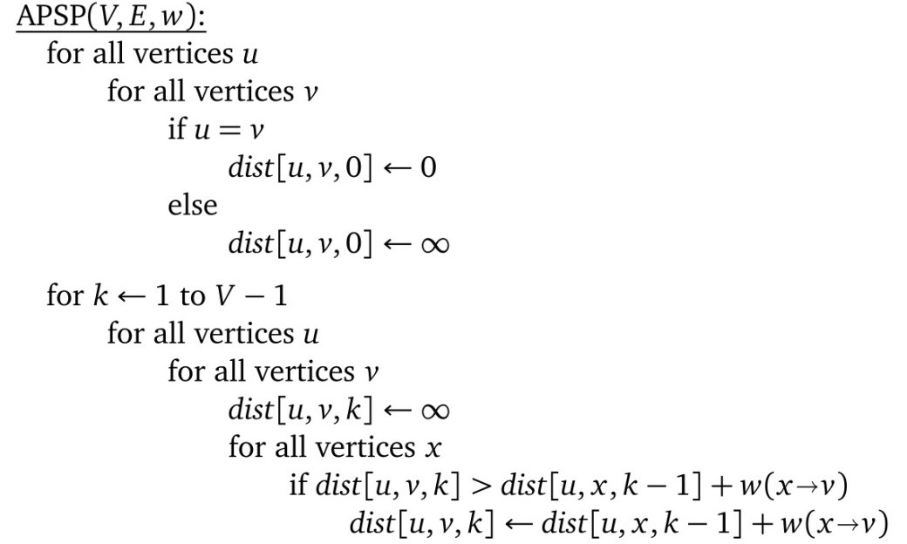








“BF Algorithm 2”
Length of the shortest of at most k edges
for every u
O(n⁴)
u
k path
k-1 path
1 path
x
v
for every x
for every v

Slide 6
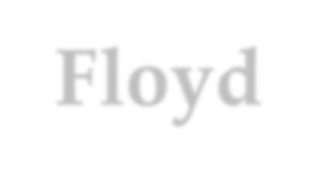

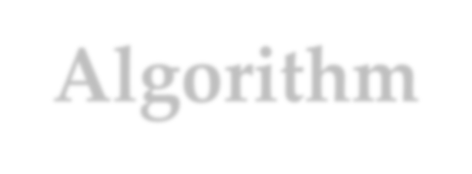

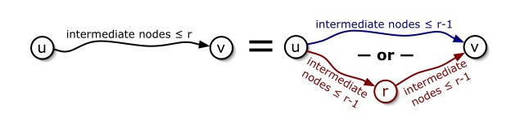

Floyd-Warshall Algorithm
Basic idea
Smart resursion

Slide 7


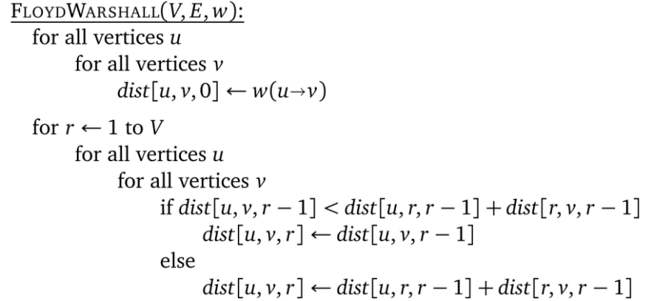

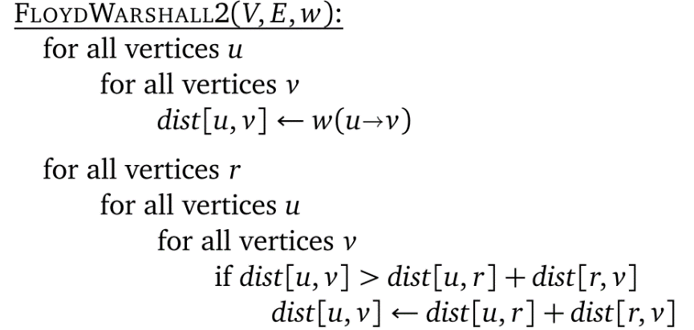
Floyd-Warhsall Algorithm
Basic DP (3-dimensional)
O(n³)
Improved DP (2-dimensional)
O(n³)

Slide 8




Edit Distance
You can edit a word by
Insert, delete, replacement
Edit distance
Minimum number of edit operations
The edit distance is 4
Problem
o Given two strings, compute the edit distance
R R I R
not possible
4 op:
3 op:

Slide 9

Recursion
Case 1
1.1 Insert
1.2: dual of case 1
Case 1
A ×
B
Case 2
2.1 a=a
2.2 a≠b
Case 3.1
A
a
B
a
Case 3.2
A
a
B
b

Slide 10
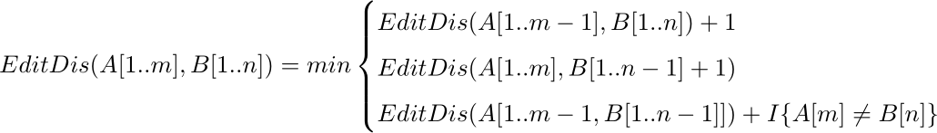
Recursion
EditDis(i,j)
Base case:
If i=0, EditDis(i,j)=j
If j=0, EditDis(i,j)=i
Recursion:

Slide 11

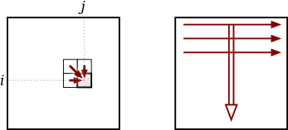
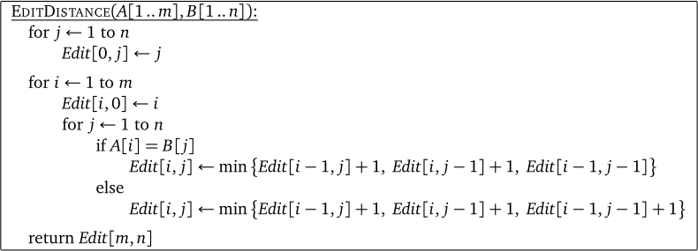
DP Solution
DP dict
o EditDis[1..m, 1..n]
dependencies
DP algorithm

Slide 12

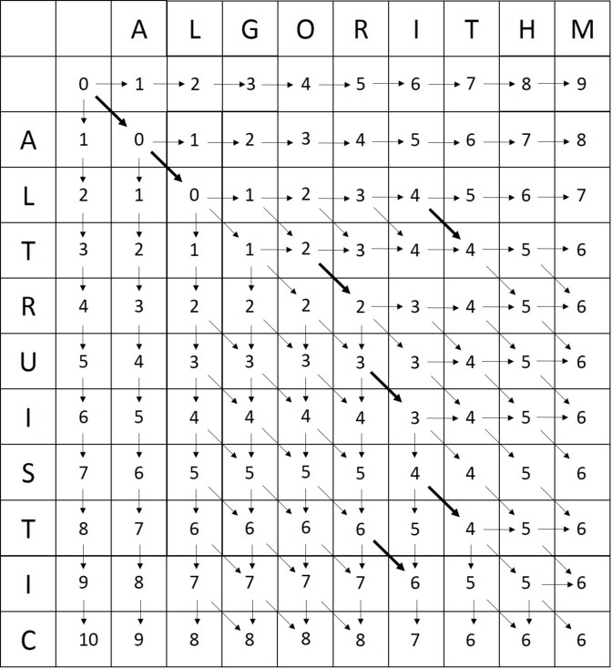
Example
algorithm
vs.
altruistic

Slide 13


Separating Sequence of Words
Words into lines
Word-length w₁, w₂, …, w_{n} and line-width: W
Basic constraint
If w_{i}, w_{i+1}, …, w_{j} are in one line, then w_{i}+w_{i+1}+ …+w_{j}≤W
Penalty for one line: some function of X. X is:
0 for the last line in a paragraph, and
W –(w_{i}+w_{i+1}+ …+w_{j}) for other lines
The problem
How to make the penalty of the paragraph, which is the sum of the penalties of individual lines, minimized

Slide 14

Greedy Solution
i word
w
Solution by greedy strategy
1 | Those | 6
2 | who | 4
3 | cannot | 7
4 | remember | 9
5 | the | 4
6 | past | 5
7 | are | 4
8 | condemned | 10
9 | to | 3
10 | repeat | 7
11 | it. | 4
words (1,2,3)
X 0
penalty 0
(4,5) (6,7) (8,9) (10,11)
4 8 4 0
64 512 64 0
Total penalty is 640
An improved solution
words (1,2) (3,4) (5,6,7)
(8,9)
(10,11)
X | 7 | 1 | 4 | 4 | 0
penalty | 343 | 1 | 64 | 64 | 0
W is 17, and penalty is X³
Total penalty is 472

Slide 15

Problem Decomposition
Representation of subproblem: a pair of indexes (i,j), breaking words i through j into lines with minimum penalty.
Two kinds of subproblem
(k, n): the penalty of the last line is 0
o all other subproblems
For some k, the combination of the optimal solution for (1,k) and (k+1,n) gives a optimal solution for (1,n).
Subproblem graph
About n² vertices
Each vertex (i,j) has a edge to about j –i other vertices, so, the number of edges is in Θ(n³)

Slide 16
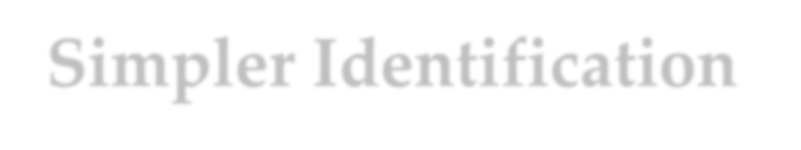

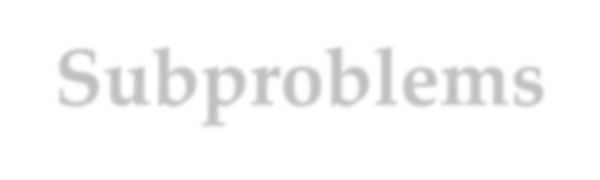
Simpler Identification of Subproblems
If a subproblem concludes the paragraph, then (k,n) can be simplified as (k)
About k subproblems
Can we eliminate the use of (i,j) with j<n?
Put the first k words in the first line(with the basic constraint satisfied), the subproblem to be solved is (k+1,n)
Optimizing the solution over all k’s. (k is at most W/2)

Slide 17







Breaking into Lines
lineBreak(w,W,i,n,L)
if (w_{i}+ w_{i+1}+…+ w_{n} ≤W)
<Put all words on line L, set penalty to 0>
else
for (k=1; w_{i}+…+w_{i+k-1}≤W; k++)
X=W-(w_{i}+…+w_{i+k-1});
In DP version this is replaced by “Recursion or Retrieve”
In DP
version, “Storing” inserted
kPenalty=lineCost(X)+lineBreak(w,W, i+k, n, L+1)
<Set penalty always to the minimum kPenalty>
<Updating k_{min}, which records the k that produced the minimum penalty>
<Put words i through i+k_{min}-1 on line L>
return penalty

Slide 18
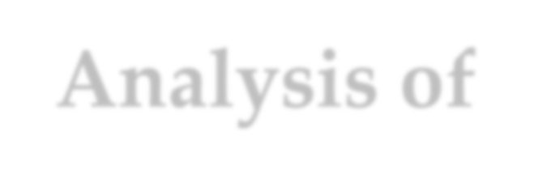
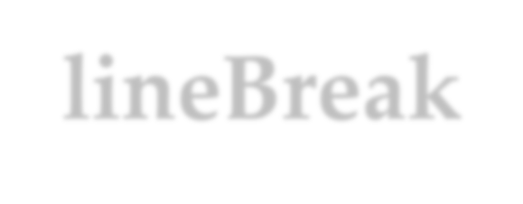

Analysis of lineBreak()
Each subproblem is identified by only one integer k, for (k,n)
Number of vertex in the subproblem graph: at most n
So, in DP version, the recursion is executed at most n times.
So, the running time is in Θ(Wn)
The loop is executed at most W/2 times.
In fact, W, the line width, is usually a constant. So, Θ(n).
The extra space for the dictionary is in Θ(n).

Slide 19

Making Change: Revisited
How to pay a given amount of money?
Using the smallest possible number of coins
With certain systems of coinage
We have known that the greedy strategy fails sometimes

Slide 20
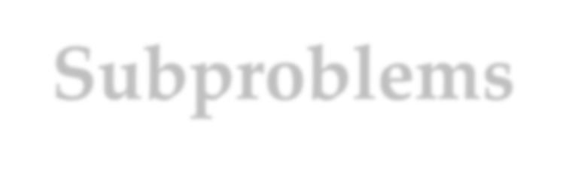
Subproblems
Assumptions
Given n different denotations
A coin of denomination i has d_{i} units
The amount to be paid: N.
Subproblem [i,j]
The minimum number of coins required to pay an amount of
j units, using only coins of denominations 1 to i.
The problem
Figure out subproblem [n, N] (as c[n,N])

Slide 21

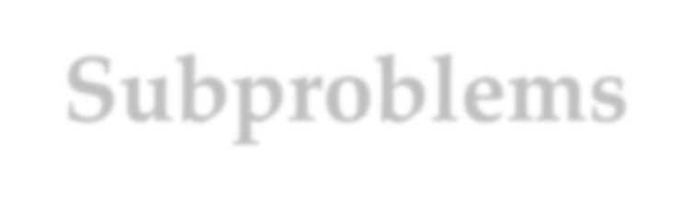
Dependency of Subproblems
c[i,0] is 0 for all i
When we are to pay an amount j using coins of denominations 1 to i, we have two choices:
No coins of denomination i is used: c[i-1, j]
One coins of denomination i is used: 1+c[i, j-d_{i}]
So, c[i,j] = min (c[i-1, j], 1+c[i, j-d_{i}])

Slide 22



Data Structure
Define a array coin[1..n, 0..N] for all c[i, j]
an example
 | 0 | 1 | 2 | 3 | 4 | 5 | 6 | 7 | 8
d₁=1 | ⎡0 | 1 | 2 | 3 | 4 | 5 | 6 | 7 | 8⎤
⎢₀
1 2 3 1 2 3 4
1 2 3 1 2 1 2
₂⎥
d =4
⎢
⎥
2⎥⎦
2
d₃=6 ⎣⎢0
direction of computation

Slide 23

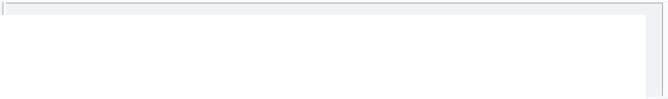
The Procedure
int coinChange(int N, int n, int[] coin)
int denomination[]=[d₁,d₂,...,d_{n}];
for (i=1; i≤n; i++) coin[i,0]=0;
for (i=1; i≤n; i++)
for (j=1; i≤N; j++)
in Θ(nN),
n is usually a constant
if (i= =1 && j<denomination[i]) coin[i,j]=+∞ ;
else if (i= =1) coin[i,j]=1+coin[1, j-denomination[1]];
else if (j<denomination[i]) coin[i,j]=cost[i-1, j];
else coin[i,j]=min(coin[i-1, j], 1+coin[i, j-denomination[i];
return coin[n,N];

Slide 24
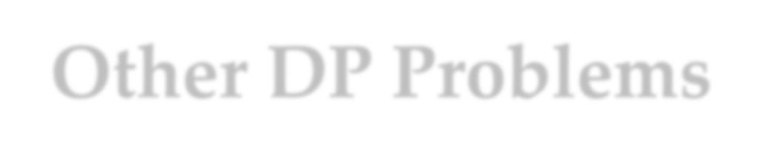
Other DP Problems
Text string problems
Longest common subsequence, …
Variations of standard text string problems
One dimensional problems
Arrangements along the road, …
Graph problems
Shortest paths over DAGs, …
Hard problems
Knapsack problems and variations, …

Slide 25


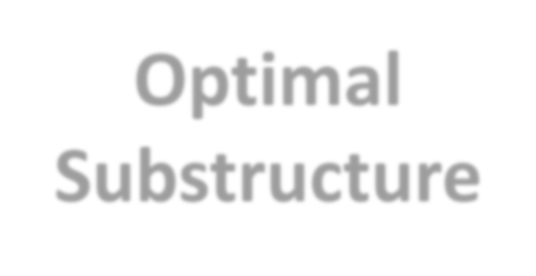
Principle of Optimality
Given an optimal sequence of decisions, each subsequence must be optimal by itself.
Positive example: shortest path
Counterexample:_{O}lon_{p}g_{t}es_{i}t_{m}(sim_{a}p_{l}le) path
DP relies on the principle of optimality
Substructure
The optimal solution to any nontrivial instance of a problem is a combination of optimal solutions to some of its sub-instances.
It is often not obvious which sub-instances are relevant to the instance under consideration.

Slide 26
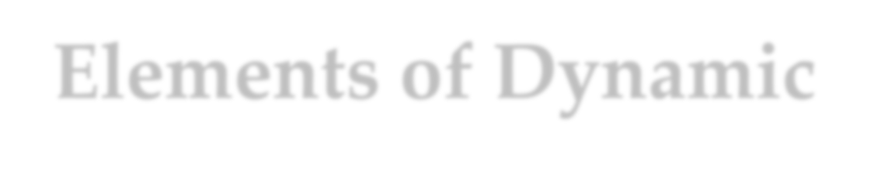



Elements of Dynamic Programming
Symptoms of DP
Overlapping subproblems
Optimal substructure
How to use DP
“Brute force” recursion
Overlapping subproblems
Smart programming
Topological sorting of subproblems
DP Dictionary

Slide 27


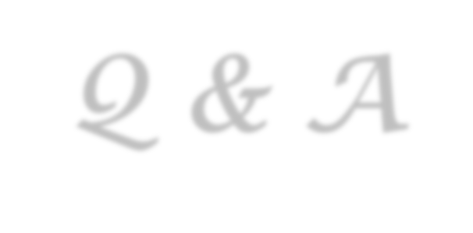

Thank you!
Q & A
Yu Huang
http://cs.nju.edu.cn/yuhuang

